Slide 1
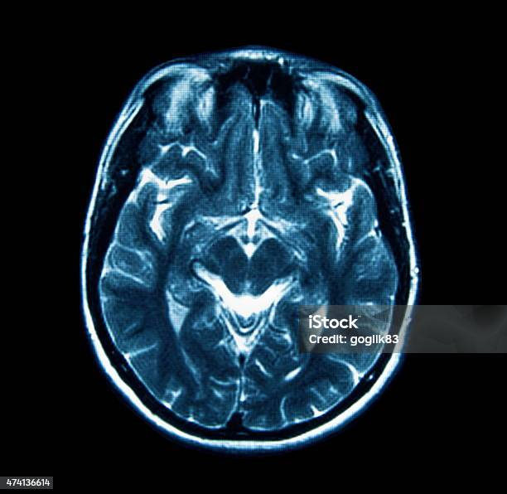

Brain Tumor MRI Classification Using Deep Learning
Team Members:
Maryam Awadallah
Nada Mostafa Kamel
Mariam Mohamed Elfar
Tasneem Ahmed
Yasmine Essam Muhammad

Slide 2

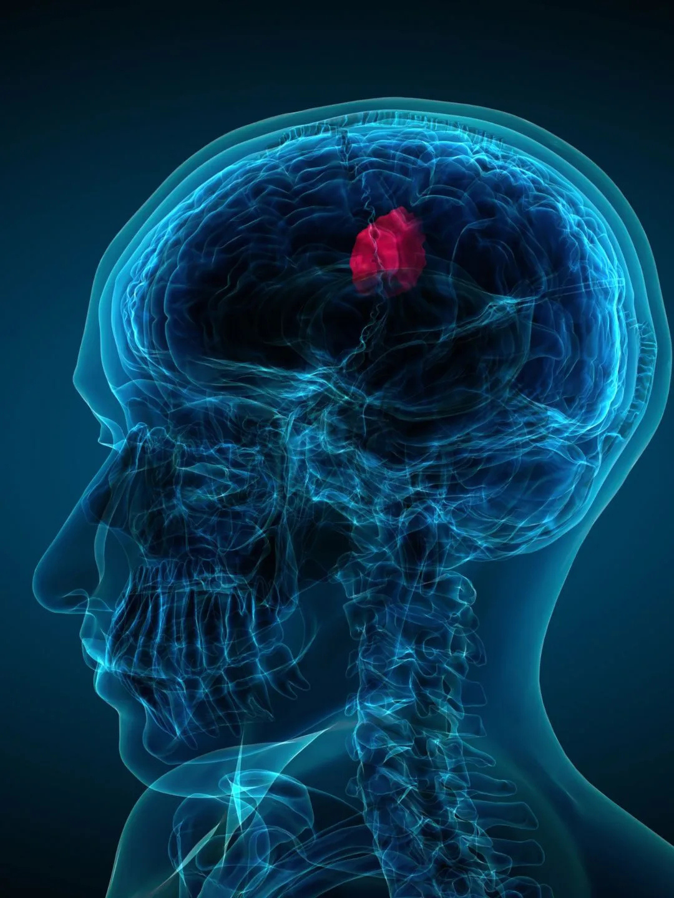
Problem Statement
Brain tumors are serious medical conditions that can be fatal if not detected early. MRI imaging is commonly used by radiologists for diagnosis.
Challenges in manual diagnosis:
Goal:
Requires extensive medical expertise
Takes a long time for analysis
Risk of human error
Develop an AI-powered classification system to help radiologists detect tumors faster and more accurately.

Slide 3



Project Objective
Use Deep Learning (VGG19) to classify brain tumors from MRI scans
Improve diagnosis speed and accuracy by reducing manual effort
Provide a Streamlit web application where anyone can upload MRI scans and get predictions
Ensure the pipeline covers data preparation, preprocessing, modeling, evaluation, and deployment

Slide 4

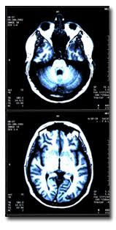
Data Sources
Data Preparation – By Nada Mostafa Kamel
Two datasets from Kaggle were combined:
Masoudnickparvar Brain Tumor MRI Dataset
Indk214 Brain Tumor Dataset
Classes included in both:
Glioma
Meningioma
Pituitary
No Tumor

Slide 5
Contribution: Nada Mostafa Kamel
Data Cleaning & Preparation
Some datasets had inconsistent class names → unified them (e.g., "pituitary tumor" → "pituitary")
Used MD5 hashing to remove duplicate MRI images across datasets
Balanced dataset by stratified splitting: Train, Validation, Test
Final dataset is well-structured and ready for preprocessing

Slide 6
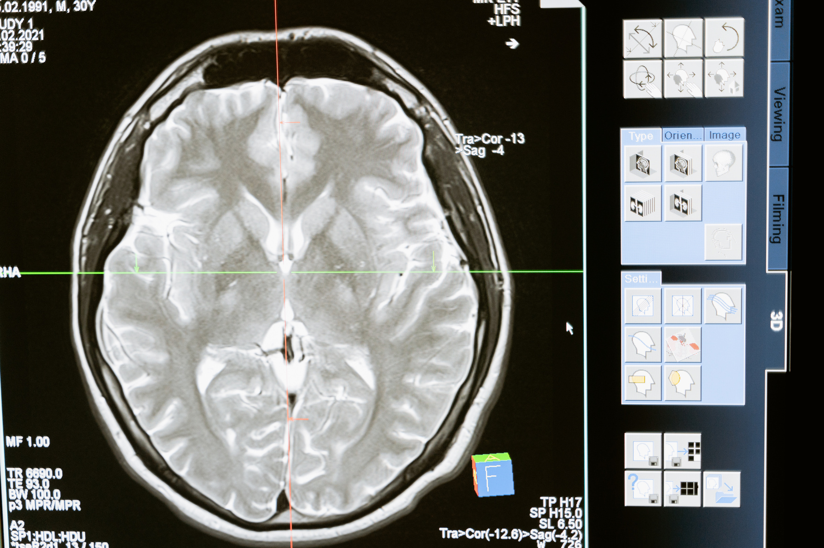
Image Preprocessing
Preprocessing & EDA – By Mariam Mohamed Elfar
Standardized all images:
Resized to 224×224 pixels (required by VGG19)
Normalized pixel values (scaled between 0–1)
These steps ensure the model processes images consistently and avoids scale bias.

Slide 7
Contribution: Mariam Mohamed Elfar
Data Augmentation
To artificially expand dataset and avoid overfitting:
Random horizontal flips
Random brightness adjustments
Random contrast changes
This allows the model to generalize better by learning from slightly modified versions of the data.

Slide 8
Contribution: Mariam Mohamed Elfar
Exploratory Data Analysis (EDA)
Visualized the class distribution with count plots
Checked dataset balance after cleaning
Verified no mislabeled data remained after unifying class names
Confirmed the dataset was suitable for model training

Slide 9
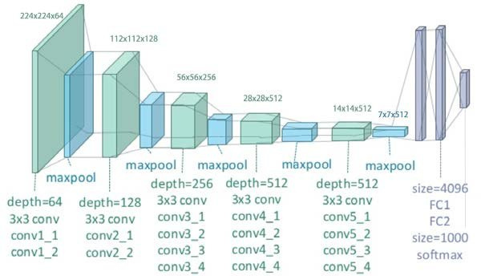
Model Choice – VGG19
Model Training – By Maryam Awadallah & Yasmine Essam Muhammad
Chose VGG19, a CNN pre-trained on ImageNet.
Benefits:
Already trained on millions of images → strong feature extraction
Transfer learning reduces training time
We froze the first 15 layers to preserve low-level features, while fine-tuning deeper layers for tumor-specific features.

Slide 10
Contribution: Maryam Awadallah & Yasmine Essam Muhammad
Custom Layers Added
After VGG19 base:
Global Average Pooling → reduces overfitting and parameters
Dense(256, ReLU) + Batch Normalization + Dropout(0.3)
Output layer: Dense(4, Softmax) → one neuron per tumor type

Slide 11
Contribution: Maryam Awadallah & Yasmine Essam Muhammad
Training Configuration
Dataset Split: 70% training, 20% validation, 10% testing
Batch Size: 16
Epochs: 30
Optimizer: Adam (lr=1e-4)
Loss Function: Sparse Categorical Crossentropy
Class Weights: balanced automatically using sklearn → handled slight imbalance across classes

Slide 12
Contribution: Maryam Awadallah & Yasmine Essam Muhammad
Training Enhancements
EarlyStopping: stopped training when no improvement in validation loss
ReduceLROnPlateau: decreased learning rate when model plateaued
ModelCheckpoint: saved the best version of the model automatically
Together, these ensured efficient training, prevented overfitting, and produced the best possible model.

Slide 13
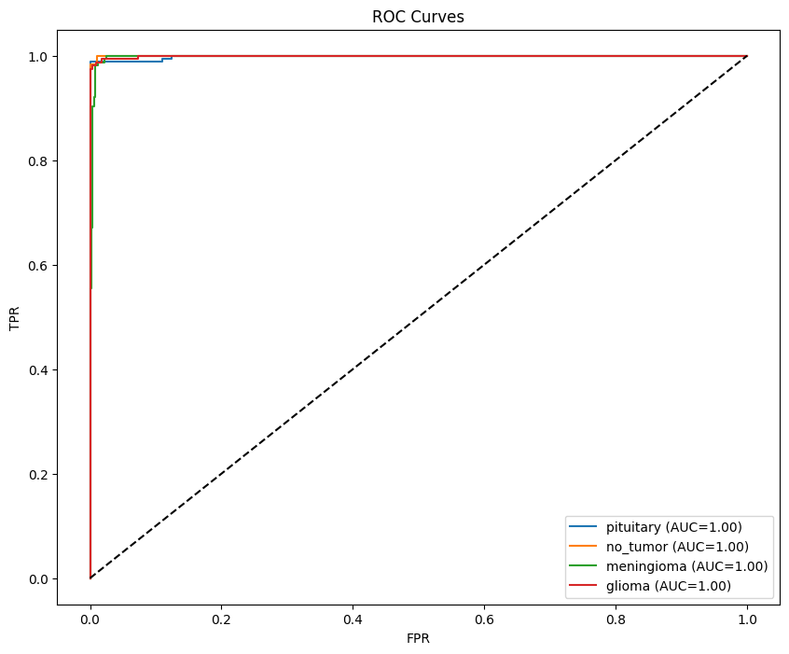
Metrics Used
Model Evaluation– By Maryam Awadallah & Yasmine Essam Muhammad
Accuracy
F1-score (Macro & Weighted)
Confusion Matrix → shows misclassifications
ROC-AUC curves → show how well the model distinguishes each class

Slide 14
Contribution: Maryam Awadallah & Yasmine Essam Muhammad
Results
Test Accuracy: ~98%
Macro F1-score: ~0.98
ROC-AUC: >0.97 across all classes
The model showed very strong performance and very few misclassifications

Slide 15
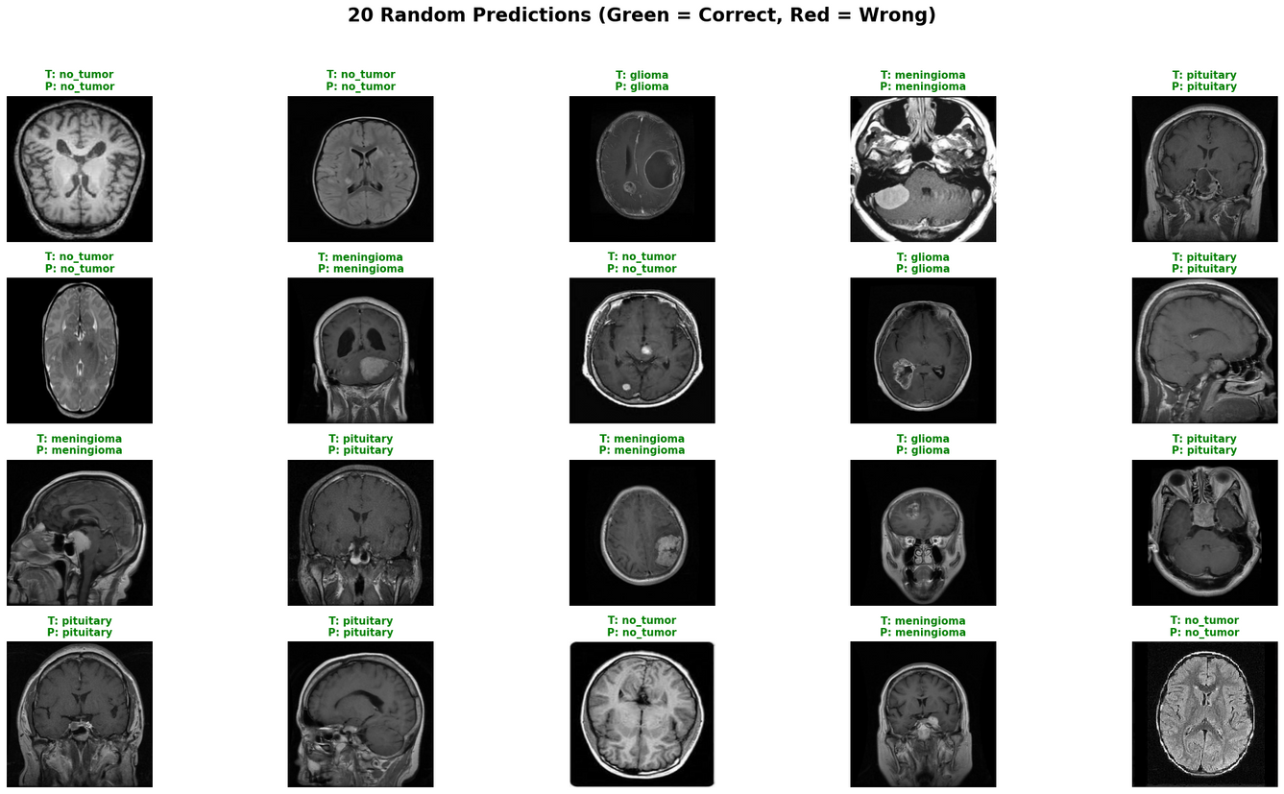
Contribution: Maryam Awadallah & Yasmine Essam Muhammad
Visualization of Results
Confusion Matrix: almost all predictions correct
ROC Curves: all curves close to top-left (excellent separability)
Sample Predictions:
Green titles = correct predictions
Red titles = incorrect predictions

Slide 16
Web Interface
Deployment – By Tasneem Ahmed
Implemented using Streamlit
Users can upload MRI images
The model automatically preprocesses (resize + normalize) and predicts tumor type

Slide 17
Roles & Contributions
1- Nada Mostafa Kamel
Data preparation (collection, cleaning, label unification, duplicate removal)
2-Mariam Mohamed Elfar
Preprocessing & EDA (resizing, normalization, augmentation, distribution analysis)
3-Maryam Awadallah & Yasmine Essam Muhammad
Model training & evaluation (VGG19 setup, training strategy, metrics, results)
4-Tasneem Ahmed
Deployment (Streamlit app, integration of preprocessing + model for real-time predictions)

Slide 18
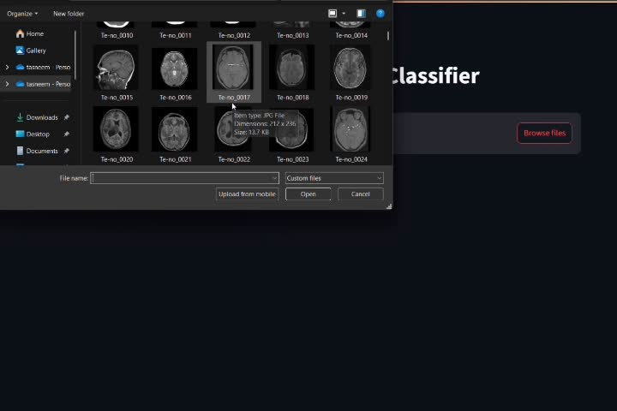



Demo video

